Slide 1



MPIG Open Seminar 0111
Photo OCR
葛明进
Machine Perception and Interaction Group (MPIG)
www.mpig.com.cn
gmj@mpig.com.cn
公众号:
mpig_robot

Slide 2
Outline:
1.Photo OCR
2.Sliding Window
3.Getting Lots of Date and Artificial Date
4.Ceiling Analysis

Slide 3
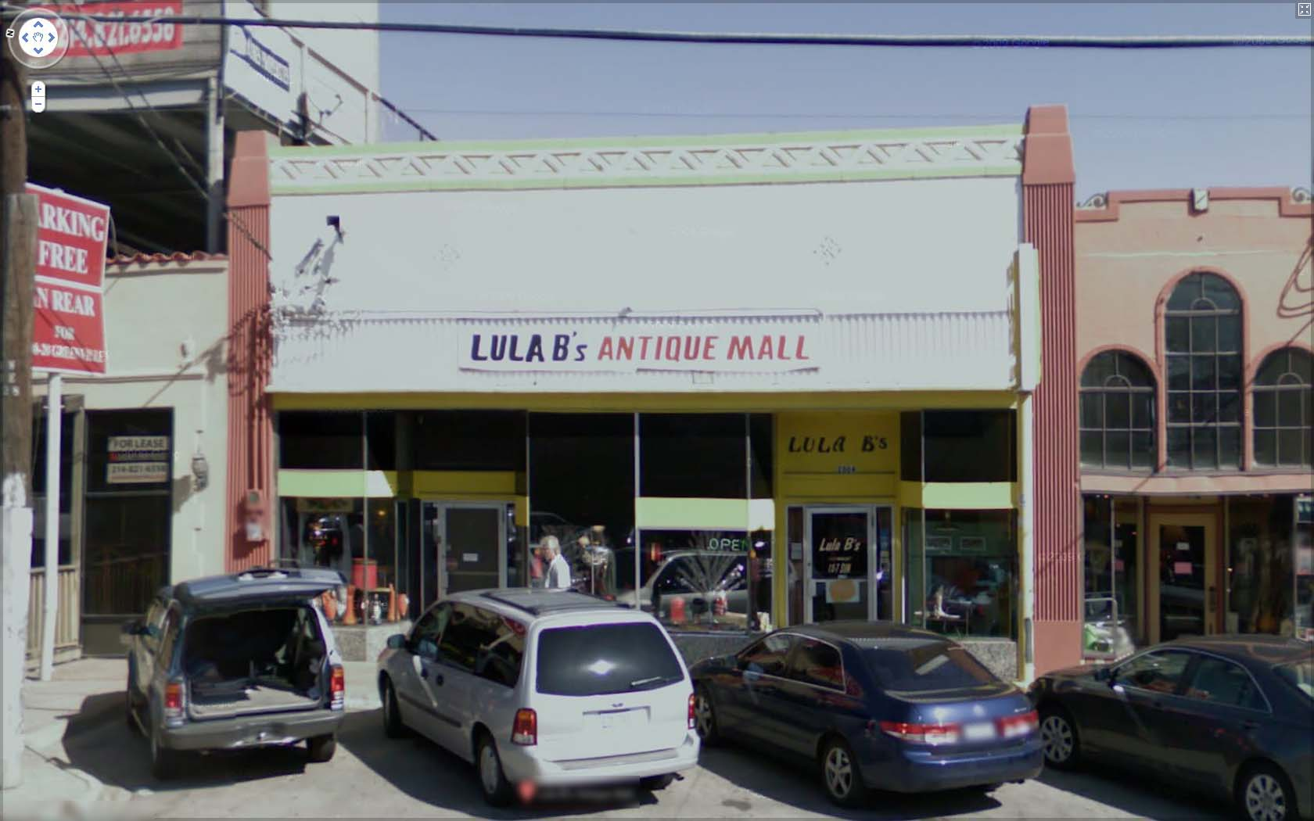
The Photo OCR problem
LULA B’s ANTIQUE MALL
LULA B’s
OPEN
LULA B’s

Slide 4
Photo OCR pipeline
1. Text detection
2. Character segmentation
3. Character classification
A
N
T

Slide 5
Photo OCR pipeline
Image
Text detection
Character segmentation
Character recognition

Slide 6
Sliding windows

Slide 7
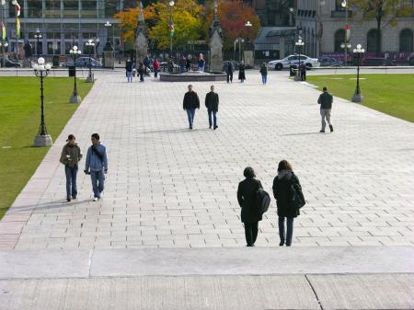
Text detection
Pedestrian detection

Slide 8
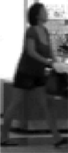
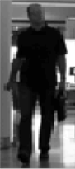
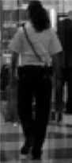
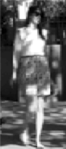
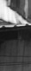
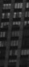


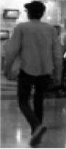
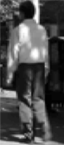
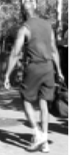
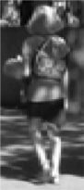
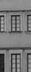
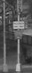
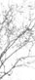
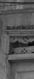
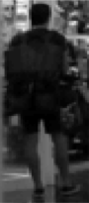
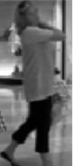
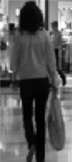
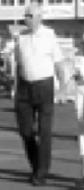
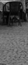
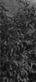



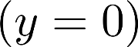
Supervised learning for pedestrian detection
pixels in 82x36 image patches
Positive examples
Negative examples

Slide 9
Sliding window detection

Slide 10
Sliding window detection

Slide 11
Sliding window detection

Slide 12
Sliding window detection

Slide 13
Text detection

Slide 14
Text detection
Positive examples
Negative examples

Slide 15
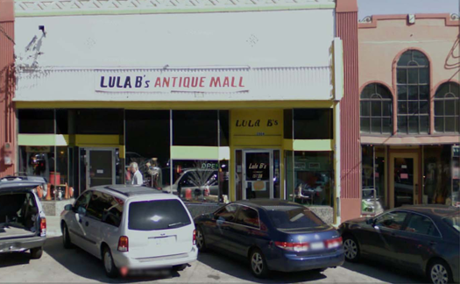


Text detection
Notes:
Expansion
Rectangles around operator

Slide 16
1D Sliding window for character segmentation
Positive examples
Negative examples
Notes:
Change it to segmentation examples instead:

Slide 17
Character recognition
A
N
T
I
Q
A
Notes:
Sort it, spell antique

Slide 18
example
% PRINCIPAL PROGRAM
warning off %#ok<WNOFF>
% Clear all
clc, close all, clear all
% Read image
imagen=imread('testcheck.bmp');
% Show image
imagen1 = imagen;
figure,imshow(imagen1);
title('INPUT IMAGE WITH NOISE')
% Convert to gray scale
if size(imagen,3)==3 %RGB image
imagen=rgb2gray(imagen);
end
% Convert to BW
threshold = graythresh(imagen);
imagen =~im2bw(imagen,threshold);
imagen2 = imagen;
%figure,imshow(imagen2);
% title('before bwareaopen')
% Remove all object containing fewer than 15 pixels
imagen = bwareaopen(imagen,15);
imagen3 = imagen;
%figure,imshow(imagen3);
%title('after bwareaopen')
%Storage matrix word from image
word=[ ];
re=imagen;
%Opens text.txt as file for write
fid = fopen('text.txt', 'wt');
% Load templates
load templates
global templates
% Compute the number of letters in template file
num_letras=size(templates,2);
while 1
%Fcn 'lines_crop' separate lines in text
[fl re]=lines_crop(re); %fl= first line, re= remaining image
imgn=fl;
n=0;
%Uncomment line below to see lines one by one
%figure,imshow(fl);pause(2)
%-----------------------------------------------------------------
spacevector = []; % to compute the total spaces betweeen
% adjacent letter
rc = fl;
while 1
%Fcn 'letter_crop' separate letters in a line
[fc rc space]=letter_crop(rc); %fc = first letter in the line
%rc = remaining cropped line
%space = space between the letter
% cropped and the next letter
%uncomment below line to see letters one by one
%figure,imshow(fc);pause(0.5)
img_r = imresize(fc,[42 24]); %resize letter so that correlation
%can be performed
n = n + 1;
spacevector(n)=space;
P65

Slide 19
%Fcn 'read_letter' correlates the cropped letter with the images
%given in the folder 'letters_numbers'
letter = read_letter(img_r,num_letras);
%letter concatenation
word = [word letter];
if isempty(rc) %breaks loop when there are no more characters
break;
end
end
%-------------------------------------------------------------------
%
max_space = max(spacevector);
no_spaces = 0;
for x= 1:n %loop to introduce space at requisite locations
if spacevector(x+no_spaces)> (0.75 * max_space)
no_spaces = no_spaces + 1;
for m = x:n
word(n+x-m+no_spaces)=word(n+x-m+no_spaces-1);
end
word(x+no_spaces) = ' ';
spacevector = [0 spacevector];
end
end
%fprintf(fid,'%s\n',lower(word));%Write 'word' in text file (lower)
fprintf(fid,'%s\n',word);%Write 'word' in text file (upper)
% Clear 'word' variable
word=[ ];
%*When the sentences finish, breaks the loop
if isempty(re) %See variable 're' in Fcn 'lines'
break
end
end
fclose(fid);
%Open 'text.txt' file
winopen('text.txt')
clear all
P65

Slide 20
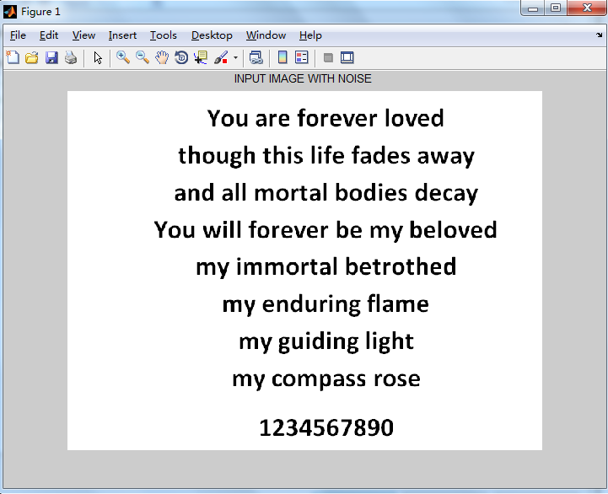
result

Slide 21
Getting lots of data:
Artificial data synthesis

Slide 22

Artificial data synthesis for photo OCR
Abcdefg
Abcdefg
Abcdefg
Abcdefg
Abcdefg
Real data

Slide 23
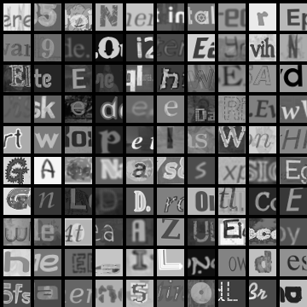
Artificial data synthesis for photo OCR
Real data
Synthetic data

Slide 24
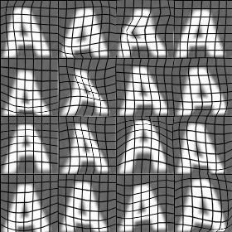
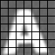
Synthesizing data by introducing distortions

Slide 25

Synthesizing data by introducing distortions: Speech recognition
Original audio:
Audio on bad cellphone connection
Noisy background: Crowd
Noisy background: Machinery

Slide 26
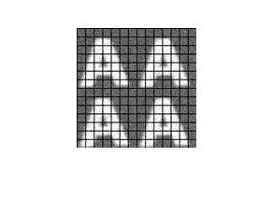
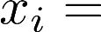
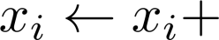
Synthesizing data by introducing distortions
Distortion introduced should be representation of the type of noise/distortions in the test set.
Audio:
Background noise,
bad cellphone connection
Usually does not help to add purely random/meaningless noise to your data.
intensity (brightness) of pixel
random noise
Notes:
2x2, add noise

Slide 27
Discussion on getting more data
Make sure you have a low bias classifier before expending the effort. (Plot learning curves). E.g. keep increasing the number of features/number of hidden units in neural network until you have a low bias classifier.
“How much work would it be to get 10x as much data as we currently have?”
Artificial data synthesis
Collect/label it yourself
“Crowd source” (E.g. Amazon Mechanical Turk)

Slide 28
Ceiling analysis:
What part of the pipeline to work on next

Slide 29
Estimating the errors due to each component (ceiling analysis)
Image
Text detection
Character segmentation
Character recognition
What part of the pipeline should you spend the most time trying to improve?
Component | Accuracy
Overall system | 72%
Text detection | 89%
Character segmentation | 90%
Character recognition | 100%

Slide 30
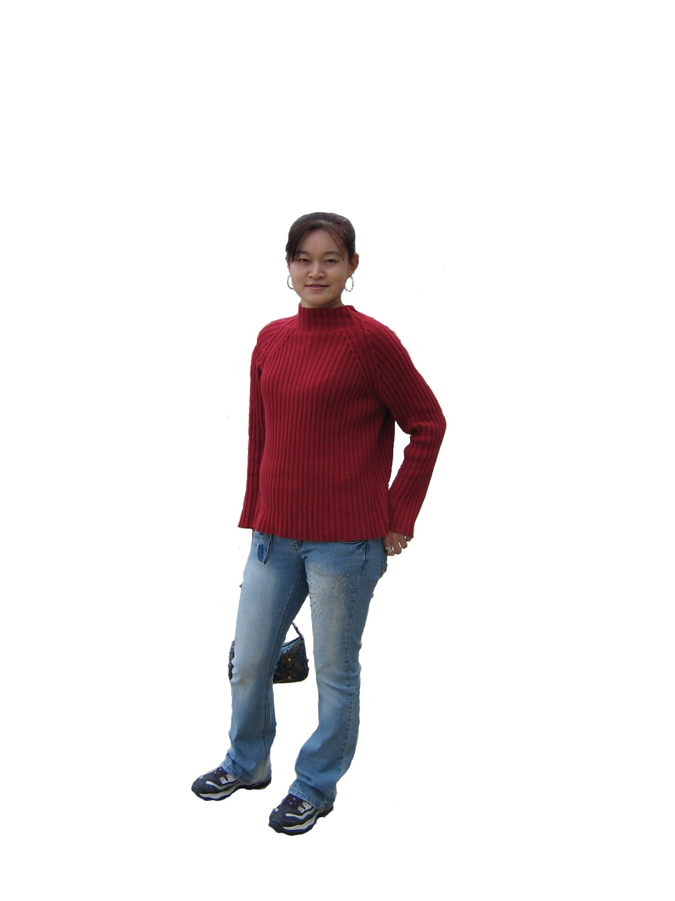
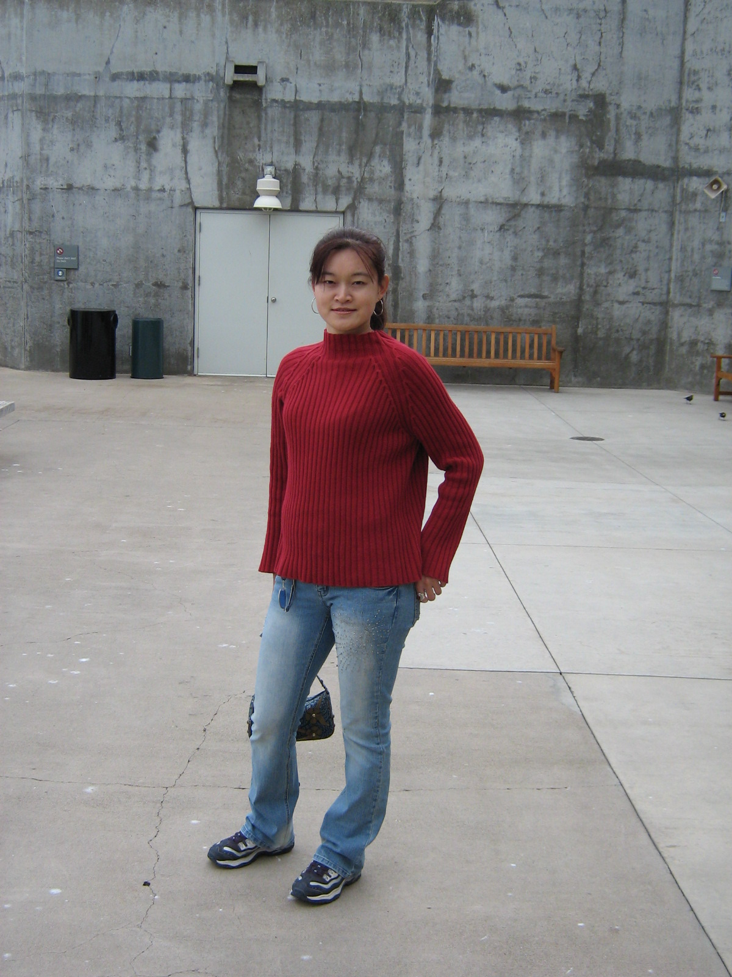
Another ceiling analysis example
Face recognition from images
(Artificial example)
Camera
image
Preprocess
(remove background)
Eyes segmentation
Face detection
Nose segmentation
Logistic regression
Label
Mouth segmentation

Slide 31
Another ceiling analysis example
Camera
image
Preprocess
(remove background)
Eyes segmentation
Logistic regression
Label
Face detection
Nose segmentation
Component | Accuracy
Overall system | 85%
Preprocess (remove background) | 85.1%
Face detection | 91%
Eyes segmentation | 95%
Nose segmentation | 96%
Mouth segmentation | 97%
Logistic regression | 100%
Mouth segmentation

Slide 32
Thanks
Machine Perception and Interaction Group (MPIG)
www.mpig.com.cn
gmj@mpig.com.cn
公众号:
mpig_robot

